Slide 1
ICE Notes application

Slide 2
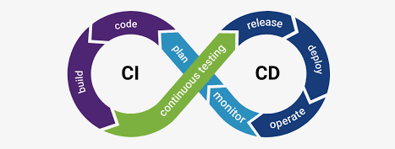
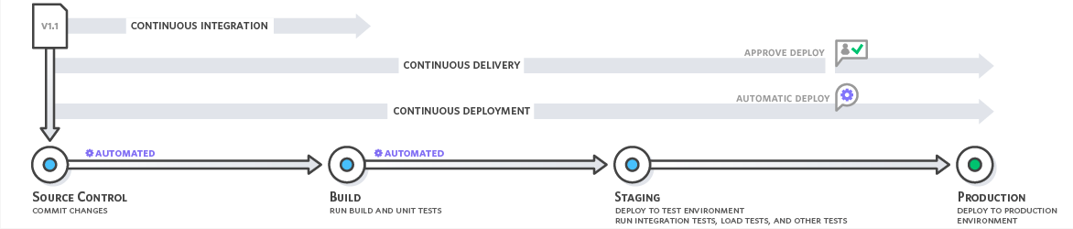
What is CI / CD?
A CI/CD pipeline is a series of steps that must be performed in order to deliver a new version of software.
A CI/CD pipeline introduces monitoring and automation to improve the process of application development, particularly at the integration and testing phases, as well as during delivery and deployment. Although it is possible to manually execute each of the steps of a CI/CD pipeline, the true value of CI/CD pipelines is realized through automation.

Slide 3
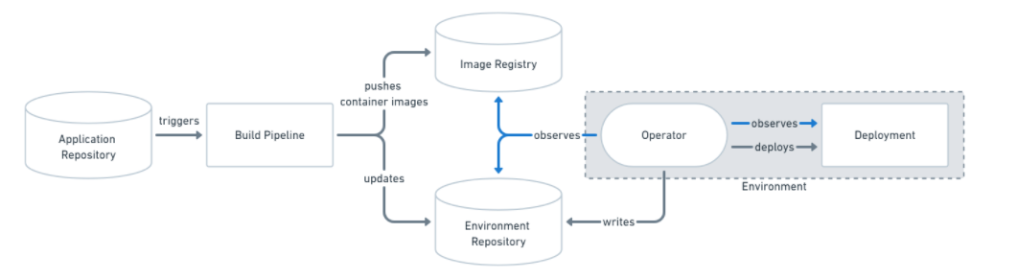
CI / CD and GitOps
CI/CD Pipeline that uses Pull-based GitOps
GitOps' Pull Based model says that an entity should watch the repository for changes, then apply them to the environment automatically which handles consistency itself. ArgoCD makes this simple to use and high leverage as a tool.

Slide 4
IceNotes demo
IceNotes application demo presentation

Slide 5
Challenges
Agreeing on the framework
Getting things started
Following the methods we learned this week
Little experience with collaboration tools

